Slide 1
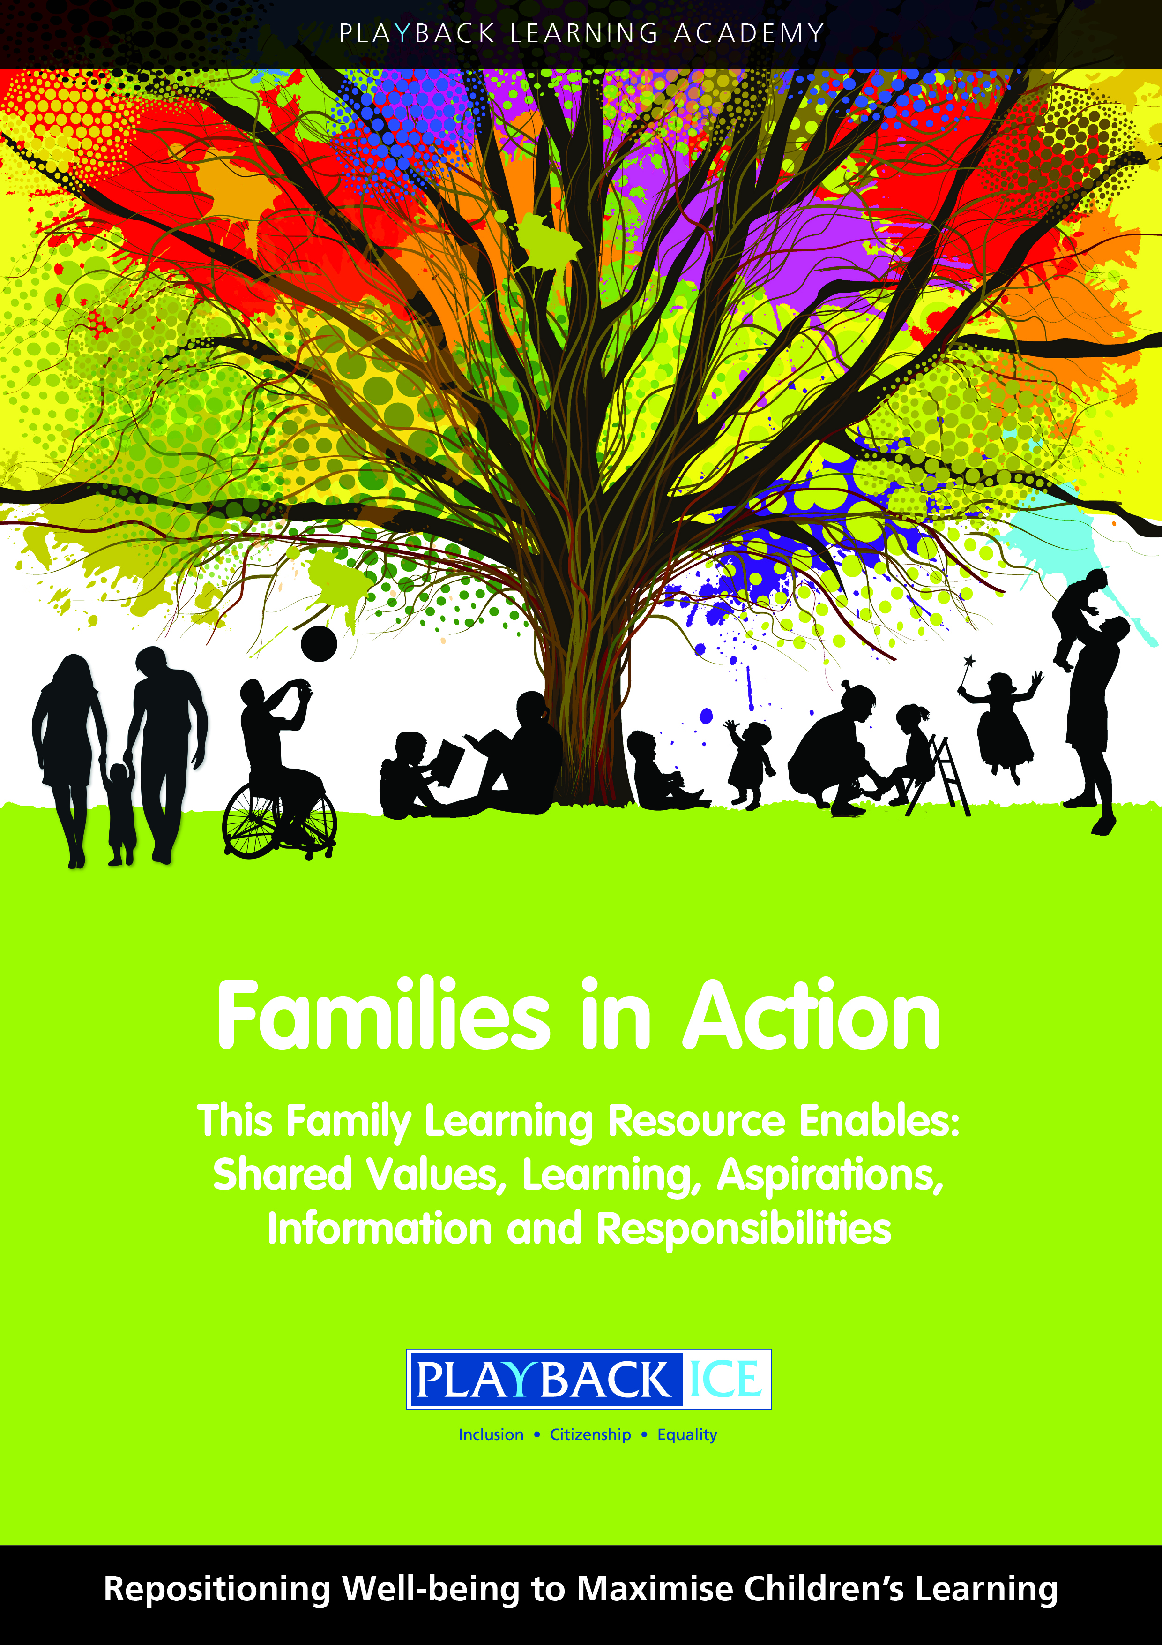
Families in Action
A Family wellbeing and
Learning Resource
Enabling families to become more engaged in their children’s wellbeing and learning.

Slide 2
Session 14:
How can we support children to develop and maintain friendships?
Playback Learning Academy

Slide 3
Session 14: How can we support children to develop and maintain friendships?
Aims to: Explore the importance of friendships Confirm what children should value in friendships

Slide 4
Introduction
Why is it important to understand the importance of friendships?
Who were your school friends? Are they are still friends etc.
Review the My Qualities Handout to agree the kind of values you would want your children to have in their friends

Slide 5
Billy’s story: Friendship
The scenario explores a situation that your child/ren could find themselves in and the impact it could have on their social and emotional wellbeing.

Slide 6
What do you think?
Is it acceptable for Billy to be friends with Jen?
Should Billy be spending time with Jen?
Should Billy’s friends stop teasing him?
Is Jen a bad influence on Billy?
What do you think makes a person have a bad influence on you?

Slide 7
What do you think?
Which people have a good or a bad influence on you?
Should Billy make more of an effort to see his friends after school?
Should we be able to have both male and female friends?
What affect would bullying have on our social and emotional wellbeing?

Slide 8
Family activity at home:
Explain the purpose of the activity and why it is important for children to:
Understand the importance of friendships
Identify what we mean by positive friendships
Complete the What do you think? questions at the end of the activity

Slide 9
Feedback/closing summary

