Slide 1
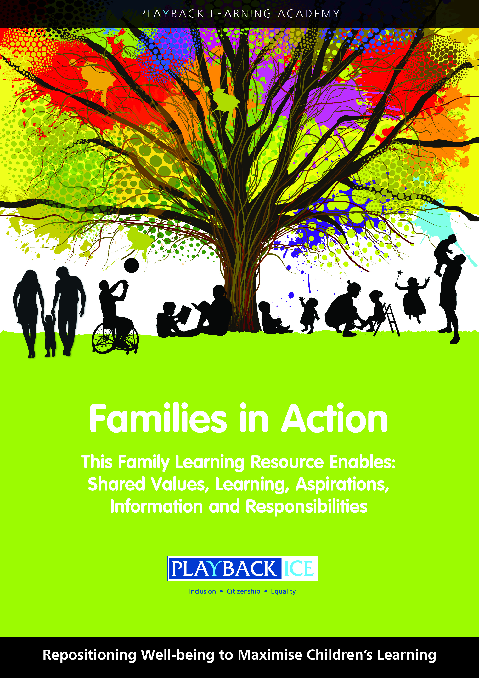
Families in Action
A Family wellbeing and
Learning Resource
Enabling families to become more engaged in their children’s wellbeing and learning.

Slide 2
What skills and qualities do children need for learning, life and work?
Session 5:
Playback Learning Academy

Slide 3
Session 5: What skills and qualities do children need for learning, life and work?
Aims to: Introduce the government’s policy in relation to skills development Explore the skills and qualities children need for learning, life and work Identify how families enable children to develop their skills and qualities

Slide 4
Introduction
Skills for learning, life and work
are the foundations already in place in school through
Curriculum for Excellence.

Slide 5
Developing Scotland’s Young Workforce (DYW) Agenda (3 -18 years)
DYW is a seven-year programme (2014-2021)
Aims to better prepare children and young people aged 3–18 for the world of work.
This programme builds on the foundations already in place through Curriculum for Excellence.

Slide 6
Developing Scotland’s Young Workforce (DYW) Agenda (3 -18 years)
The headline aim of Developing the Young Workforce
is to reduce youth unemployment by 40% by 2021.

Slide 7
Key Themes to:
Increase the route from schools into employment, or further education
Engage with young people, parents/carers, teachers and practitioners, partners and employers
Support teachers and practitioners to develop children and young people's learning about the world of work
Provide earlier relevant, labour-market focused career advice
Embed meaningful employer involvement

Slide 8
Key Themes to:
Consolidate partnership working with colleges and other training providers
Ensure young people access more vocational options during the senior phase of secondary school
Improve opportunities and experiences for all learners, with a focus on reducing gender imbalance on course take-up
Develop foundation apprenticeships in schools
Develop stronger partnerships between employers and education

Slide 9
Discuss
Why do we all need to work together to ensure children have the right skills to take their place in society and are equipped to pursue a career/job of their choice?
What is the importance of skills and qualities on children’s health and wellbeing and their ability to aspire and develop?

Slide 10
Being able to identify their skills and qualities helps children to:
Have a better understanding of their current skills and qualities and next steps in development
Understand why it is important to link qualities and skills to a realistic and achievable future career
Understand that they may change their minds about career choices as they mature and develop and skills and qualities required by employers could be different

Slide 11
Skills describe what people ‘can do’.
Skills can be enhanced and developed through situations, experiences and practice e.g. you improve your skills through working in a team, using a calculator, remembering information or practising
The more you practise something, the better you should become at it
Skills can also be known as core skills, including; communication, numeracy, ICT, working with others and problem solving

Slide 12
Qualities say something about the type of person you are.
Qualities can be enhanced and developed through experiences of different situations
Qualities can include our ability to care for others, being kind, respectful, showing compassion, and understanding

Slide 13
What are essential skills?
What do we mean by essential skills and the kind of skills employers are looking for ?
We talk about skills for learning, life and work, soft skills, core skills, employability skills, transferable skills etc.
How do we know what children actually need to be successful?

Slide 14
Discuss – My Skills and Qualities
Confirm parents’/carers’ understanding by describing what skills and qualities they would value in their children.
Consider the My Skills and Qualities handout – what skills and qualities should my children have?
List the top skills and qualities you would like your children to have

Slide 15
Playback Consultation
Playback consulted with over 2000 teachers who identified the skills and qualities they think are important for children
Discuss the Teachers Top 20 Skills handout

Slide 16
No | Teachers Top Twenty Skills
1 | Resilience
2 | Communication skills – listening
3 | Empathy
4 | Respect for self and others
5 | Independence
6 | Social skills - self-awareness - building, maintaining healthy relationships
7 | Knowledge of how to keep healthy – informed healthy choices – physical/food/sleep/exercise
8 | Self-confidence
9 | Responsibility for self/own behaviour
10 | Co-operative/collaborative learning skills

Slide 17
No | Teachers Top Twenty Skills
11 | Team working
12 | Tolerance/patience
13 | Growth mindset
14 | Kindness
15 | Manners
16 | Anger management skills and strategies
17 | Emotional Intelligence - understanding & expressing feelings appropriately
18 | Self-esteem
19 | Personal hygiene/care
20 | Perseverance

Slide 18
Discuss the STEMNET Top Ten Skills handout
This handout describes the
Skills employers identified as important.

Slide 19
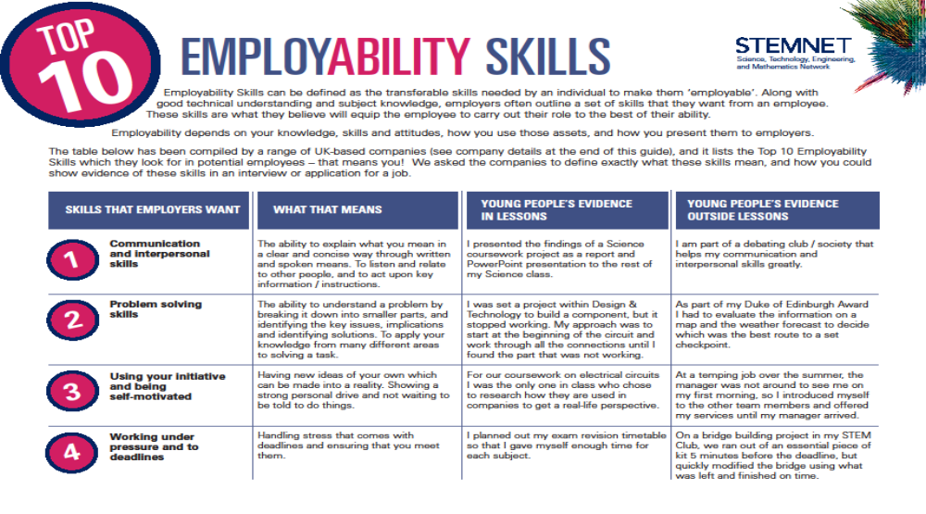

Slide 20
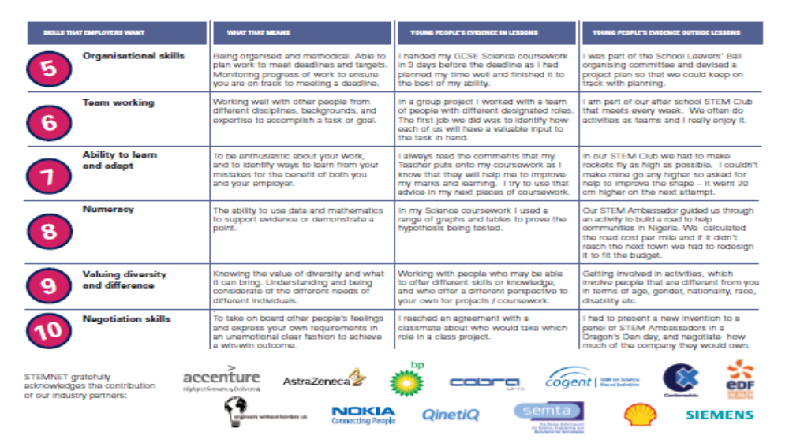

Slide 21
Does anything surprise you about these skills?
Many of the skills identified are known as core transferrable skills. These are skills that people might need in many jobs.
Both teachers and employers also identified the importance of soft skills such as: resilience, empathy, respect etc. as well as the core essential skills.

Slide 22
Core Transferable Skills include:
Numeracy - through planning money management and budgeting
Literacy - through written work
Work ethic - work experience and volunteering components
Action planning - through personal planning and goal setting exercises

Slide 23
Core Transferable Skills include:
Communication Skills - through written work, group discussion and debates
Interpersonal Skills - through group discussion and debates
ICT - researching issues and topics
Reading - informed reading through media articles and web information
Problem solving - through group work and activities

Slide 24
Family activity at home:
Explain the purpose of the activity including why it is important for children to understand:
The skills and qualities they think they have
How parents/carers could support them to develop and maintain new skills and qualities
What they would like to do in the future in relation to a possible career
The skills and qualities they will required to do this

Slide 25
Family activity at home:
Support your child to complete My Personal Plan to their next steps.

Slide 26
Feedback/closing summary

